Slide 1
Maps
By: Awvik

Slide 2
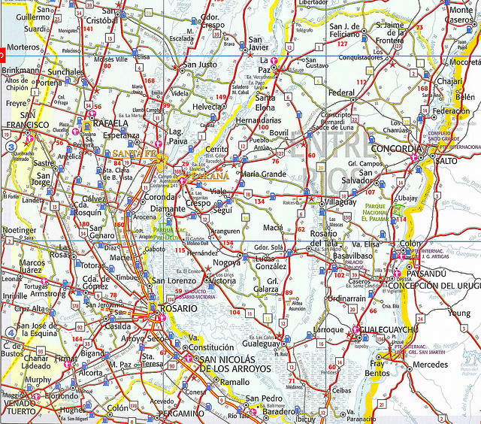
Road Map
Maps of roads, intersections, streets, highways

Slide 3
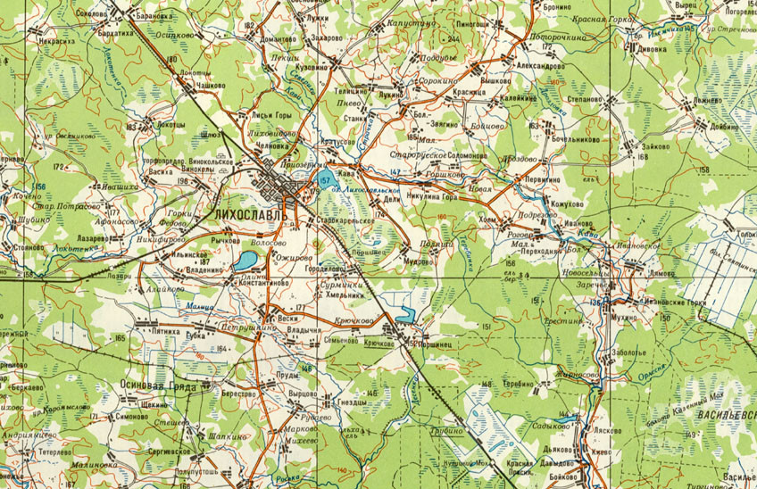
Topographic Map
Maps of the land, elevation, altitude, topography

Slide 4
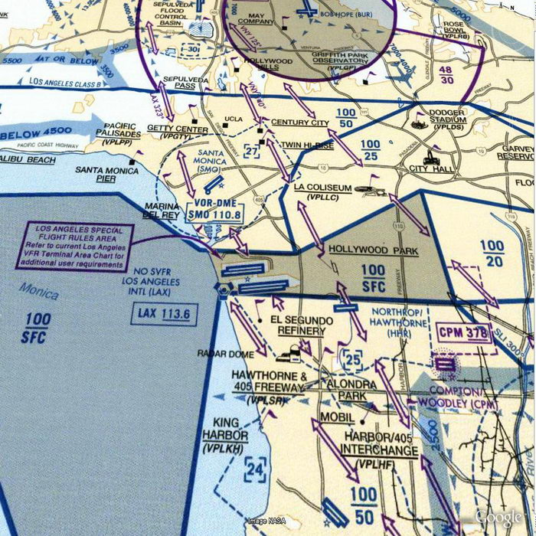
Aeronautical Map
Map specifically for aircrafts

Slide 5
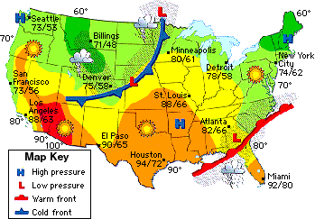
Weather Map
A Map that shows weather of a certain area or place.

Slide 6
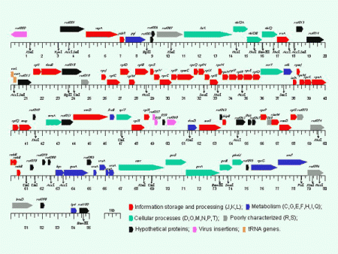
Gene Map
A record of the DNA sequence of a gene

Slide 7
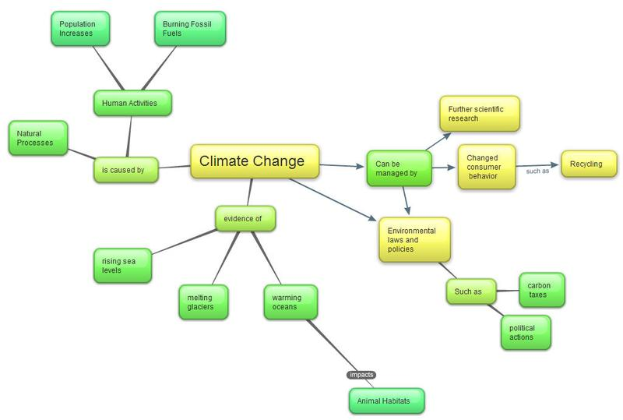
Concept Map
Map showing relationships between ideas, images, and words.

Slide 8
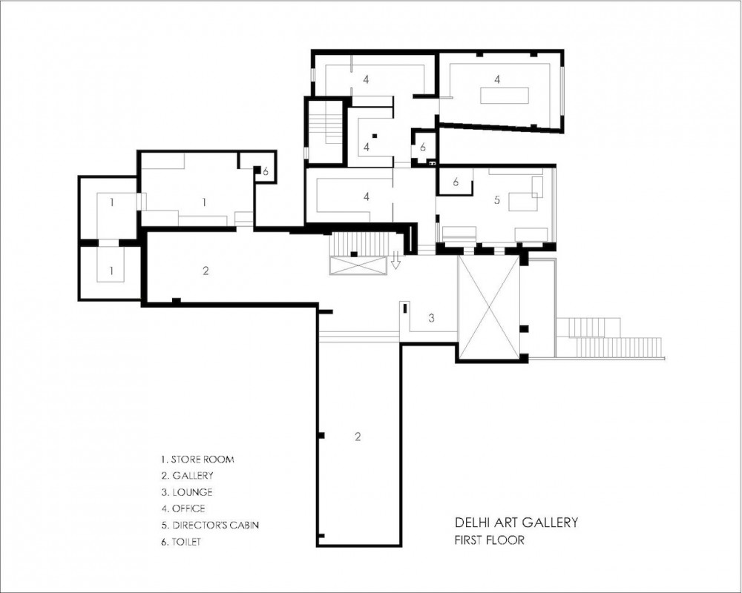
Floor Plan
a scale diagram of the arrangement of rooms in one story of a building.

